Slide 1
Chapter 4: Multivariate state-space models for animal movement

Slide 2
Multivariate models
Discretization

Slide 3

Multivariate models
How to solve multivariate dynamics:
Dynamics often involve multiple variables
Diffusion-taxis movement:
$$∂s=∇h\left(s\right)+σ∂W∂t$$
How to discretize in time?

Slide 4
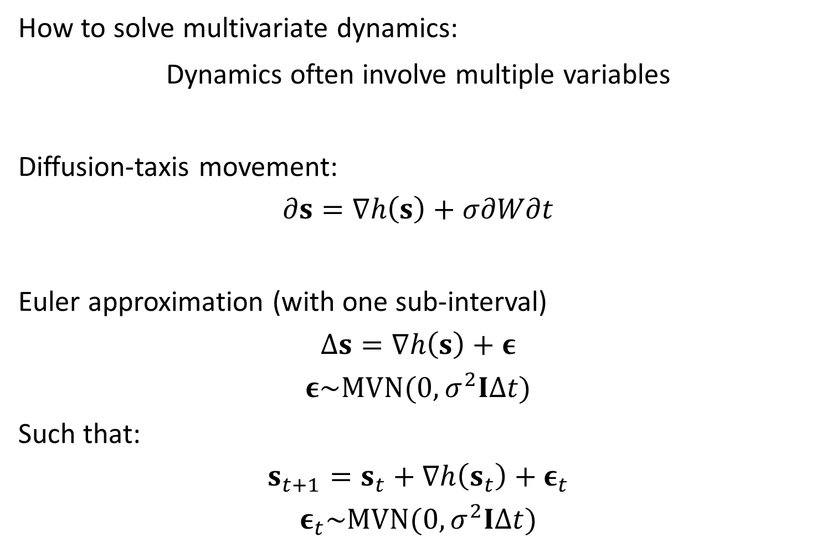
Multivariate models
How to solve multivariate dynamics:
Dynamics often involve multiple variables
Diffusion-taxis movement:
$$∂s=∇h\left(s\right)+σ∂W∂t$$
Euler approximation (with one sub-interval)
$$Δs=∇h\left(s\right)+ε$$
$$ε\sim MVN(0,σ^{2}IΔt)$$
Such that:
$$s_{t+1}=s_{t}+∇h\left(s_{t}\right)+ε_{t}$$
$$ε_{t}\sim MVN(0,σ^{2}IΔt)$$

Slide 5
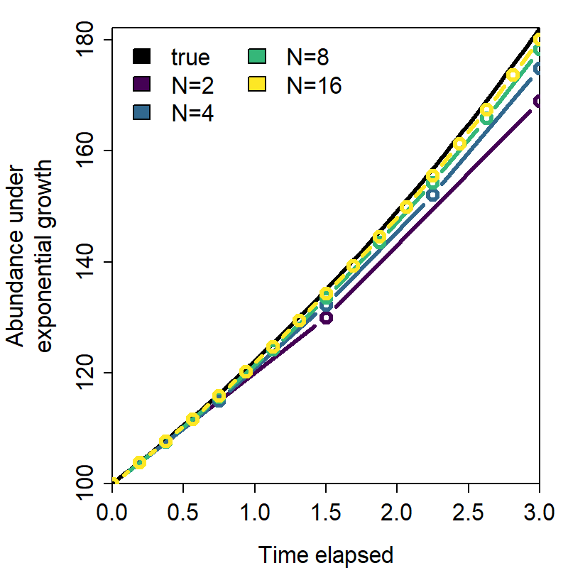
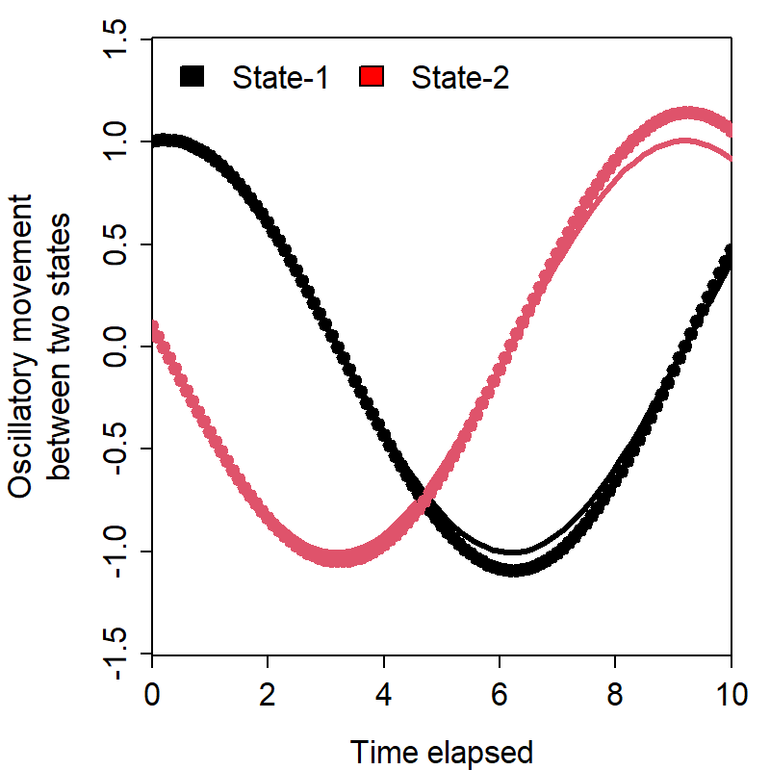


Multivariate models
Euler approximation gets better with more sub-intervals
Exponential growth
$$δN=αN×δt$$
$$N\left(t\right)=N\left(0\right)e^{αt}$$
Lotka-Volterra
$$δX=\left(αX+βY\right)δt \\ δY=\left(γX+θY\right)δt$$

